Slide 1
TWO WAY AUTHENTICATIONSYSTEM
USING RASPBERRY PI
Submitted in the partial fulfillment for the award of the degree of
BACHELOR OF ENGINEERING
IN
INFORMATION SECURITY
Submitted by:
MENDA MANMADHA RAO - 21BCS3544
PENTAKOTA SRI PRANEETH - 21BCS3511
ARNAV GUPTA - 21BCS10946
Under the Supervision of:
Arunima Sengupta
(15895)
Department of AIT-CSE
DISCOVER . LEARN . EMPOWER

Slide 2
Outline
Introduction of the project
Planning to Implement
Preliminary design of the project
Methodology
Analysis of features

Slide 3
Introduction to Project
Two way authentication is a security system that requires two separate forms of identification in order to access something.
The first factor is a password and the second commonly includes a text with a code sent to your smartphone, or biometrics using your fingerprint, face, or retina ...
Two-factor authentication (2FA) to boost security for your important accounts is becoming a lot more common these days.

Slide 4

RASPBERRY pi
It is a capable little device that enables people of all ages to explore computing, and to learn how to program in languages like Scratch and Python
The Raspberry Pi is a low cost, credit card sized computer that plugs into a computer monitor or TV, and uses a standard keyboard and mouse.
The main advantages of Raspberry-pi is:
Faster Processor…
Supports all types of codes…
Multiple sensors. …
Peripheral support.

Slide 5
IMPLEMENTATION PLANNING
Anyone can access your device from a remote location using your IP address and this will create a serious security risk for all the Raspberry Pi users out there.
A permanent solution to cope with this issue and a Two-Factor Authentication system will be a perfect option for your device as it will add extra security protection and prevent other users from accessing your device without your permission.
The authentication system will function on your mobile device and it can be done through QR code or using a strong password

Slide 6
First we need to do the upgrade our system pi and enabling the SSH.
Requiring identity authentication with challenge-response.
Configuring two factor authentication.
Create a connection: linking a system pi to the laptop or mobile device.

Slide 7
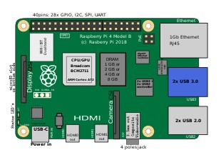
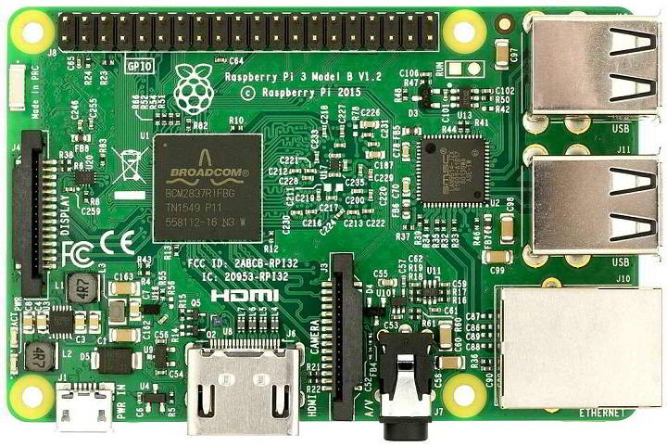
Preliminary design of the project

Slide 8
1. Central Processing unit : It is the computer’s brain and carries out instructions using logical and mathematical operations. Raspberry Pi makes use of the ARM11 series processor on its boards. 2. HDMI Port : High Definition Multimedia Interface port that allows the device to have video options of the output from the computer displayed 3. Graphic Processing Unit :Its primary purpose is to hasten the speed of image calculations. 4. Memory : Random Access Memory is a core part of a computer’s processing system. It is where real-time information is stored for easy access. 5. Ethernet port : The Ethernet port is a connectivity hardware feature available on B models of Raspberry Pi. The Ethernet port enables wired internet access to the minicomputer. 6. SD Card slot : Raspberry Pi must have some sort of storage device. However, unlike conventional PCs, it does not come with a hard drive, nor does it come with a memory card.

Slide 9
7. General purpose input and output (GPIO): They are essential parts of the Raspberry Pi device as they add to its diverse applications. GPIO pins are used to interact with other electronic circuits. They can read and control the electric signals from other boards or devices based on how the user programs them. 8. LEDs : These are a group of five light-emitting diodes. They signal the user on the present status of the Raspberry Pi unit I) PWR: this functions solely to indicate power status. II) ACT : this flashes to indicate any form od SD card activity III) LNK : it gives orange light to signify that active Ethernet connectively to be established IV) 100 : this light comes during ethernet connection speed reached 100 Mbps V) FDX : this is also comes on during ethernet connection , it is full-duplex 9.USB ports : They allow the computer to connect to a keyboard, mouse, hard drives, etc. 10. Power source : The amount of electricity any Raspberry Pi consumes depends on what it’s used for and the number of peripheral hardware devices connected.

Slide 10
Methodology Password Authentication
Main methodology used for two step authentication is a password authentication.
Passwords are the most common methods of authentication.
Passwords can be in the form of a string of letters, numbers, or special characters.
To protect yourself you need to create strong passwords that include a combination of all possible options.
This approach add the extra layer of the protection in the network systems.

Slide 11
Analysis of features in Raspberry pi
General Purpose Input/Output (GPIO) Pins. ...
Low Power Consumption. ...
Operating System Support. ...
Compact Size. ...
Video and Graphics Support. ...
Wireless Connectivity. ...
Expandability.

Slide 12
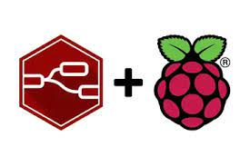
Analysing data on Raspberry Pi : 1. Deciding what to measure and finding sensors to collect data 2. Reading sensors and storing the data 3. Analyzing data by applying filters, and correlating. 4. Visualizing the data on a graph or dashboard

